Slide 1
Part 1: Introduction to wireless networking management
Paola Soto and Miguel Camelo

Slide 2
Agenda
Part I – Introduction to wireless networking management
Background in Wi-Fi and its medium access mechanisms.
Background in Channel Bonding
Challenges in Channel Bonding
Necessity for digital twins
Part II – Hands-on: Building an NDT for Next-Generation WLANs with traditional AI/ML/DL
Introduction to dataset
Introduction to AI/ML/DL techniques
Hands on: Building an NDT with traditional AI/ML/DL
Part III – Hands-on: Building an NDT for Next-Generation WLANs using Graph Neural Networks
Motivation for using Graph Neural Networks (GNNs) in topology-based problems
Introduction to GNNs
Hands-on: Building an NDT for Next-Generation WLANs using GNNs
Part IV – State of the art and beyond

Slide 3


Who are we
Ph.D. student – UAntwerpen & imec
M. Sc. in Telecommunications Engineering – UdeA
Current research: developing network management strategies using artificial intelligence and machine learning.
Email: paola.soto-arenas@uantwerpen.be
Senior Researcher - UAntwerpen & imec
Ph.D. in Computer Engineering – UdG
SCATTER – DARPA competition
leads the research track on applied artificial intelligence in networking.

Slide 4
Introduction to Wi – Fi

Slide 5

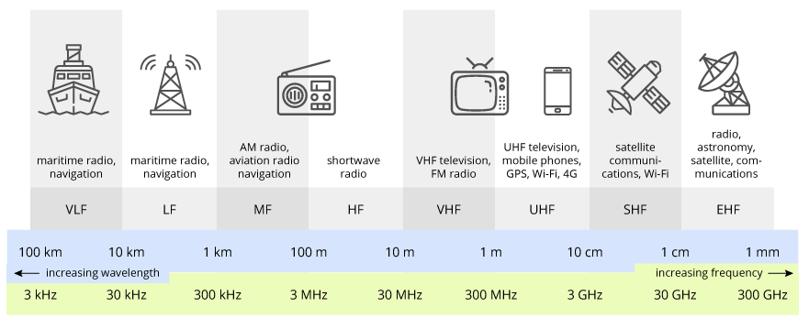




Wi-Fi Background
Introduction
Technically known as IEEE802.11 (back in 1999).
Mainly uses the 2.4GHz and the 5GHz radio spectrum bands (a.k.a. unlicensed spectrum).
The spectrum is shared with other technologies.
Listen before talk mechanisms – spectrum sensing
Source: https://terasense.com/terahertz-technology/radio-frequency-bands/
Notes:
Wi-Fi is one of the most used technologies for internet access in residential and enterprise scenarios (indoor scenarios).
The transmissions made through Wi-Fi connections are using the unlicensed spectrum.
The ITU, which is an entity responsible for regulating the spectrum use at international level, assigned the 2.4GHz and more recently, the 5GHz spectrum bands for Wi-Fi transmissions, sharing this piece of spectrum with other technologies such as bluetooth or in the near future, private deployments of LTE.
So it is common to have deployments like the one shown in the picture, where multiple devices (Smart TVs and cellphones) are connected to different antennas capable of wireless transmissions.
How comes that the transmissions are not colliding with each other? Because they have spectrum sensing capabilities to only send the transmissions if the spectrum is free.

Slide 6
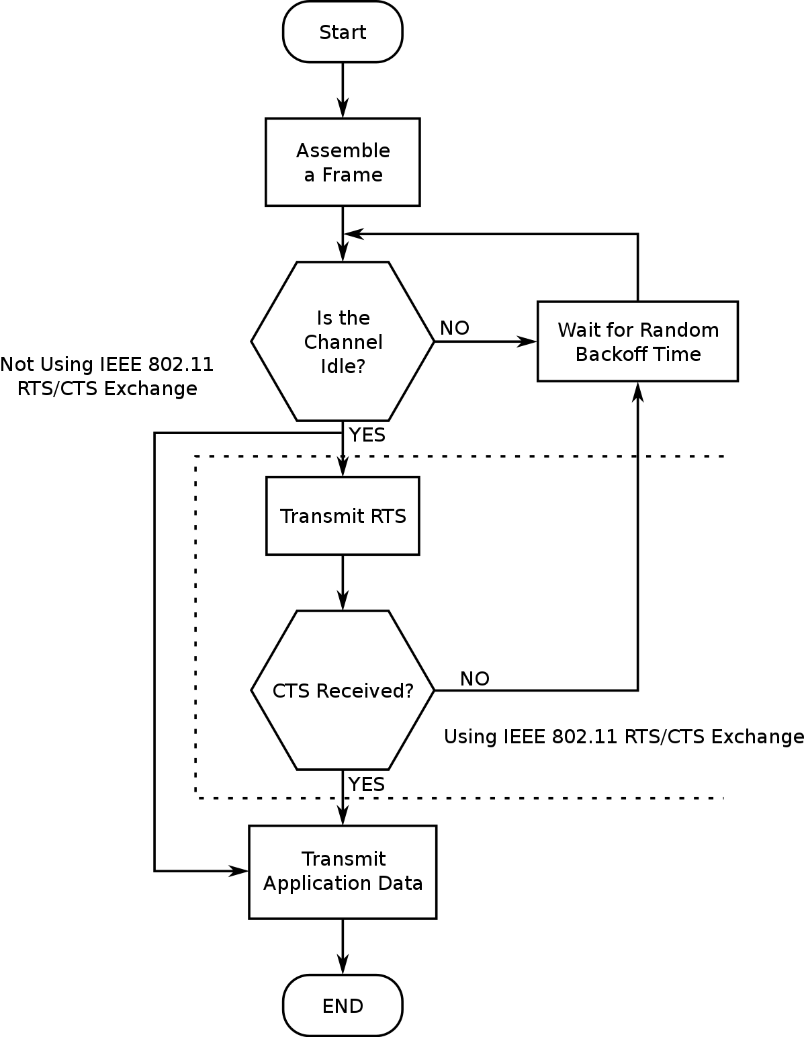
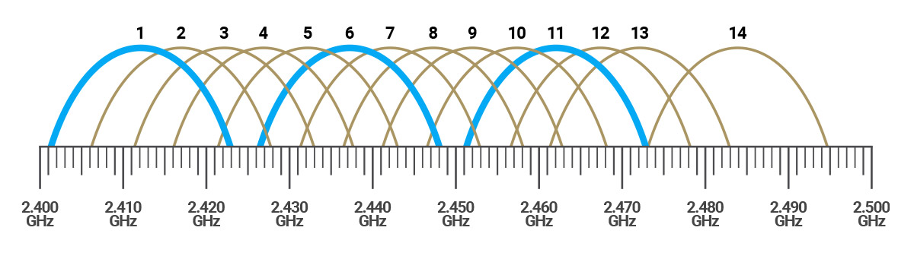
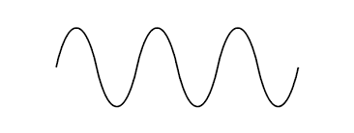
Wi-Fi Background
Spectrum Sharing in Wi-Fi
Through protocols Wi-Fi shares the spectrum with same/other technologies.
Carrier Sense Multiple Access/Collision Avoidance (CSMA/CA)
Source: https://www.engeniustech.com/go-guide-channel-transmit-power-wi-fi-networks-2/
Source: https://en.wikipedia.org/wiki/Carrier-sense_multiple_access_with_collision_avoidance
Notes:
Wi-Fi is a really polite technology, which uses an algorithm called CSMA/CA to avoid to interfere with other wireless communications.
Typically, Wi-Fi is configured to operate in given channels (commonly, orthogonal channels since they do not interfere with each other – 1, 6, 11).
For each transmission in a given channel, the sender sense the transmission medium to identify if it’s idle or not. If the transmission medium is not idle, the sender will hold its transmission for a random period of time (Backoff). → Carrier Sense (CS)
The CS will continue until the medium is free to transmit.
Even if the medium is sensed idle, the transmission can cause collisions (see the hidden node problem). For newer versions of Wi-Fi, a Request To Send (RTS) is sent to the AP. The station only sends data when it receives a Clear To Send (CTS) message.

Slide 7
Introduction to Channel Bonding

Slide 8
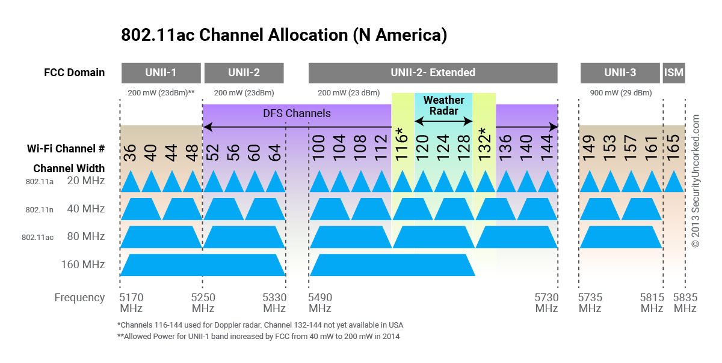
Channel Bonding
Increase available bandwidth
Typical bandwidth in Wi-Fi is 20MHz
Key Idea: Improve capacity by bonding frequency channels
CSMA/CA is still valid.
Can have different channel access policies
Source: https://www.engeniustech.com/go-guide-channel-transmit-power-wi-fi-networks-2/
Notes:
Typically, Wi-Fi transmissions occupy 20MHz bandwidth. However, with channel bonding, two or more adjacent channels can be used for transmission. This increases the allocated bandwidth per transmission and more data can be transmitted per unit of time.
In this case, the CSMA/CA mechanism will check the medium only in the primary channel.

Slide 9
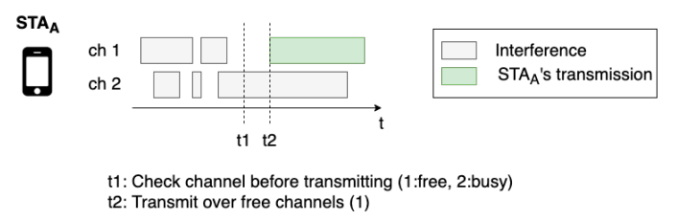
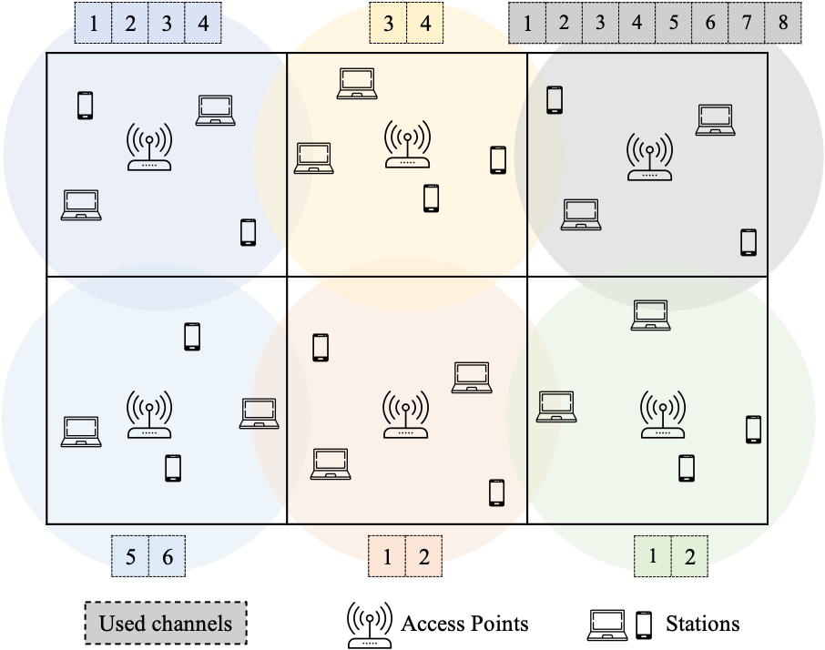



Channel Bonding
Increase available bandwidth
Dynamic Access Policy
Static Access Policy
Ch 1
Ch 2
Ch 3
Ch 4
Interference
STA
STA
transmission
t₁
t₂
t₃
t₄
1. F. Wilhelmi, D. Goez, P. Soto, et al, “Machine learning for performance prediction of channel bonding in next-generation IEEE 802.11 WLANs”, ITU Journal on Future and Evolving Technologies, Volume 2 (2021), Issue 4 - AI and machine learning solutions in 5G and future networks, Pages 67-79.
Notes:
Typically, Wi-Fi transmissions occupy 20MHz bandwidth. However, with channel bonding, two or more adjacent channels can be used for transmission. This increases the allocated bandwidth per transmission and more data can be transmitted per unit of time.
In this case, the CSMA/CA mechanism will check the medium only in the primary channel.
With CSMA, the station is only able to transmit when your allocated channels are sensed free. Depending on the policy your AP is configured to follow, this may lead to problems like starvation, because of the lack of coordination between devices.
If you are the only station that is transmitting, then the solution for improved throughput is trivial, just select the higher number of channels to be bonded, so you have higher bandwidth to transmit. But this is not always possible due to the CSMA algorithm.

Slide 10

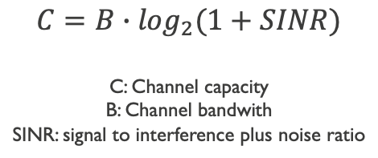
Channel Bonding
Challenges
1
The quality of the transmission (e.g., throughput, delay) depends on the Tx power & Channel effects
Channel(s): 1
$$C=B∙\log_{2}(1+SINR)$$
C: Channel capacity
B: Channel bandwith
SINR: signal to interference plus noise ratio
AP_{A}
RSSI: -67dBm
STA_{A}
Throughput: 20Mbps
Source: https://www.itu.int/en/ITU-T/AI/challenge/2020/Documents/ITU%20AI_ML%20Challenge%20-%20UPF.pdf
Notes:
There is a tradeoff between the channel width, the data rate (determined by your modulation scheme) and the contention (gain access to the medium). Then, the more bandwidth you have, the more channel capacity, but at the same time, the more interference, the less the channel capacity.
The transmission power is spread over the multiple channels, so, the more channels you can bond, the more bandwidth, and therefore, the more channel capacity.
Let’s assume that we only have a WLAN (BSS – Basic Service Set) that is using only channel one. Let’s say that with the RSSI (signal strenght) referenced here, the STA can achieve a throughput of 20Mbps.

Slide 11
Channel Bonding
Challenges
1 | 2 | 3 | 4 | 5 | 6 | 7 | 8
Channel(s): 1-8
The throughput is not x8 since the transmission power is spread over the spectrum
AP_{A}
RSSI: -80dBm
STA_{A}
Throughput: 60Mbps
Source: https://www.itu.int/en/ITU-T/AI/challenge/2020/Documents/ITU%20AI_ML%20Challenge%20-%20UPF.pdf
Notes:
There is a tradeoff between the channel width, the data rate (determined by your modulation scheme) and the contention (gain access to the medium). Then, the more bandwidth you have, the more channel capacity, but at the same time, the more interference, the less the channel capacity.
The transmission power is spread over the multiple channels, so, the more channels you can bond, the more bandwidth, and therefore, the more channel capacity.
Let’s assume that we only have a WLAN (BSS – Basic Service Set) that is using only channel ine. Let’s say that with the RSSI (signal strenght) referenced here, the STA can achieve a throughput of 20Mbps.
However, if the STA is located a little bit further away, having an RSSI of -80dBm the throuhput is not necessarly eight times the previous throughput. Since the power is lower, the modulation that it needs to use is having a lower datarate and therefore the throughput is not as expected.
The situation is worsened if you have more devices and more WLANs in the area.
So ideally, the APs should have a way to predict their expected throughput using a given configuration.
It is clear that channel bonding is a combinatorial state space problem where analytical models and Markov models will fail due to the higher complexity.

Slide 12
Digital Twins

Slide 13
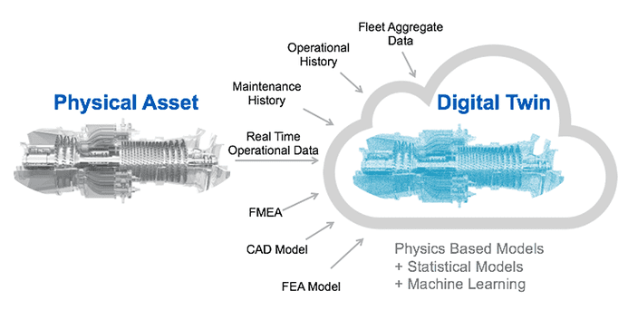
Digital Twins
Introduction
Digital representation of a physical element.
Monitored data to enhance the operational view of the physical system.
Applied to networks, a Digital Twin it’s a network model.
What-if analysis → What is the obtained throughput under this configuration?
Network planning and optimization → Can the network support another demand?
Source: https://www.motioncontroltips.com/what-are-digital-twins-how-are-they-used-in-industrial-manufacturing/

Slide 14


Digital Twins
Why a NDT is needed in next generation WLANs?
(1). Measurements
(e.g., network state)
(3). Expected performance
(4). Channel
Configurations
Controller
Network Digital Twin
(2). Set of configurations to evaluate
(1). Measurements
(e.g., network state)
Notes:
Network models and optimization algorithms are developed for assisting network providers to configure the network. In this way, network administrators set an intent (e.g., maximize the throughput) as input to the optimization algorithm, and through the model, the algorithm finds the network configuration that fulfils the requirements.
Ideally, future networks will offer a high degree of automation and this process could be completely automatic without human intervention. How? By having an accurate network digital twin that can analyse in real-time, the data received from the network and gives recommendations about configurations, for instance.
Firstly, different measurements are constantly collected from the network and delivered to the controller. The collected measurements constitute the network state. The measuring time depends on the kind of decision that is being optimized. For instance, long-term metrics, such as energy consumption, do not require short monitoring intervals. Although some of the features are difficult to get, we expect that the introduction of Software Defined Networking (SDN) in wireless networks will facilitate the data collection campaigns, where the collected data can later be used for intelligent management decisions.
Then, the evaluation of different configurations will be executed in a timely manner if a triggering condition is met, forming a closed control-loop, for example, if the controller perceives that 50% of their managed devices have lower throughput than expected. In this case, the ML model will generate a prediction for every evaluated configuration. Note that a traditional model (e.g., Markov model) takes a long time to generate a prediction, longer than the time required to optimize the spectrum usage to decrease interference and improve the user experience

